Slide 1
Restaurant Recommender
Team 11

Slide 2
Proposal
Pain point: Finding and choosing a restaurant to eat at.
Concept:
Responsive web app
Generates restaurant suggestions based on location & user preferences
APIs:
Facebook – log in
Yelp – Restaurant information
Goal:
Help users discover new restaurants
Make the entire process – from discovery, to eating – as simple as possible

Slide 3
Process
Login
Create a Food Mood
Query Yelp
List
Create account
Use Facebook
Name
Description
Tags
Location
Search elements
Store result IDs
Option details
Next option
Save option

Slide 4
Architecture choice
Client: AngularJS
Server: Node.js with Express.js framework
Data: MongoDB with Mongoose ODM

Slide 5
Use Cases
Alternate Flows & Exceptions
Generate recommendation
View wish list
Create account
Use Facebook
Invalid information
Create Food Mood
Remove from restaurant
Log In
Incomplete entry
Next
Save to wish list
Exit Food Mood
No restaurants found

Slide 6

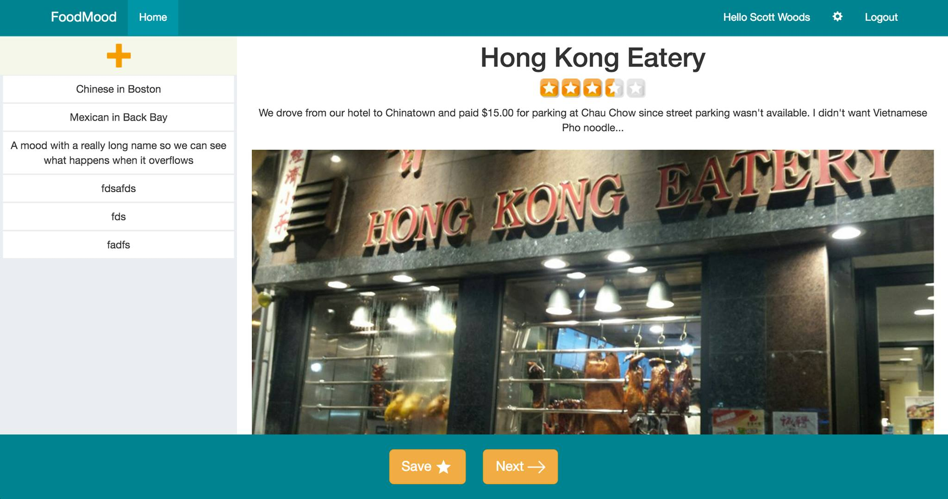
The app

Slide 7
Questions?
Thank you.

Slide 8
Use Case 1 Log in
Description: The user must log in using existing credential
Normal flow
UC-1.0 User logs in
Alternative flows:
UC-1.1 User must create account
UC-1.12 User enters invalid log in information
UC-1.3 User chooses to log in with Facebook

Slide 9
Use Case 2 Create restaurant category
Description: User creates a restaurant category based off of inputted attributes
Normal flow:
UC-2.0 Create a restaurant category
Alternate flows:
UC-2.1 User does not complete food mood

Slide 10
Use Case 3 Generate Restaurant recommendation
Description: After selecting an existing restaurant category or generating a new one, the system will return a recommendation based on the category
Normal flow:
UC-3.0 Generate a restaurant recommendation
Alternate flows:
UC-3.1 User does not select recommended restaurant
UC-3.2 User saves the restaurant
UC-3.3 User does not select any restaurant
Exceptions:
UC-3.0.E.1 Cannot find any recommendations

Slide 11
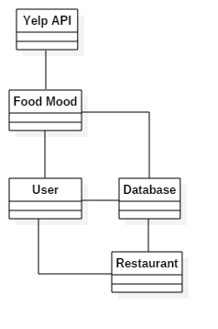
Use case 3 Class diagram

Slide 12
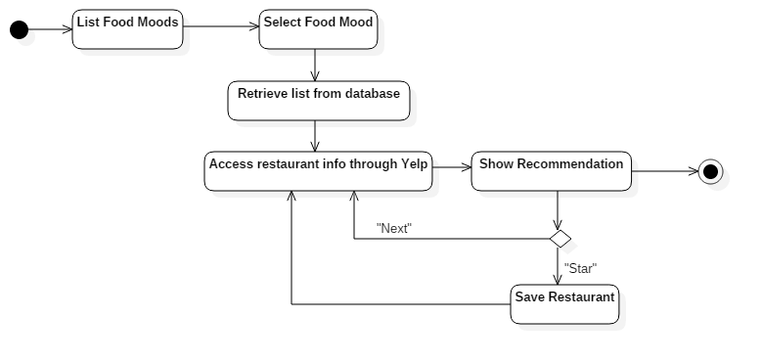
Use case 3 Activity diagram

Slide 13
Use Case 4 Save restaurant to wish list
Description: User can access the list of restaurants that they have “starred” in the past
Normal flow:
UC-4.0 View wish list
Alternate flows:
UC-4.1 Remove item from wish list

Slide 14
Example: Use API & Display search results

Slide 15
Example: retrieve results from database

Slide 16
testing
Form Field Validation
Data Validation
UI Validation
Remediation

